Slide 1
Abstract Class and Interface
Dr. B Padmaja
Dean, Career Development Centre
IARE

Slide 2
Introduction to Abstract Class
An abstract class is a class that is declared using the abstract keyword and is designed to serve as a base (or parent) class for other classes.
It can contain both abstract and concrete methods.
An abstract method is a method without a body, which must be implemented by its subclass.
abstract class ClassName {
abstract void methodName(); // abstract method
void normalMethod() { // concrete method
System.out.println("This is a concrete method.");
}
}

Slide 3
Key Features of Abstract Classes
Declared using the abstract keyword
abstract class Shape {
// ... }
Cannot be instantiated You cannot create an object of an abstract class directly:
Shape s = new Shape(); // ❌ Error
Can have both abstract and non-abstract methods
Abstract methods → declared but not defined (no body).
Non-abstract methods → have full implementation.
abstract class Shape {
abstract void draw(); // abstract method (no body)
void display() { // concrete method
System.out.println("Displaying the shape");
}
}

Slide 4
Abstract methods must be implemented by subclasses
class Circle extends Shape {
void draw() {
System.out.println("Drawing a circle"); }
}
Can have constructors, fields and static methods Even though you can’t create objects of an abstract class, constructors are called when a subclass object is created.
abstract class Shape {
Shape() {
System.out.println("Shape constructor called"); // special kind of constructor which can’t be
} used to create object
}
class Circle extends Shape { // extends -> Single level inheritance
Circle() {
System.out.println("Circle constructor called"); }
}
public class Main {
public static void main(String[] args) {
Shape s = new Circle();
Circle c = new Circle(); } // Here object is created for Circle class
}

Slide 5
Advantages and Uses of Abstract Class
Promotes code reusability and maintainability.
Provides a common base for related classes.
Helps in achieving runtime polymorphism.
Uses of Abstract Class:
When you have a common base but need shared code among subclasses.
When some methods are common but others are specific to subclasses.
Example: Shape, Vehicle, BankAccount.

Slide 6
Interface In Java
An interface in Java is a fully abstract class that is used to define a contract or set of rules that implementing classes must follow.
It defines what a class should do, but not how it should do it.
Declared using the keyword interface. Cannot be instantiated directly.
Can contain:
Abstract methods (by default)
Static methods
Default methods (from Java 8 onwards)
Private methods (from Java 9 onwards)
Variables are public, static, and final by default. Supports multiple inheritance (a class can implement multiple interfaces).
interface InterfaceName {
void method1(); // public and abstract by default
void method2();
}

Slide 7
Difference Between Abstract Class and Interface
Feature | Abstract Class | Interface
Keyword | abstract | interface
Methods | Can have abstract & concrete methods | All methods are abstract (except default/static)
Variables | Can have instance variables | Variables are public, static, and final
Constructors | Can have constructors | Cannot have constructors
Inheritance | Supports single inheritance | Supports multiple inheritance
Access Modifiers | Can use any access modifier | All methods are public by default
Type of Abstraction | Partial (0–100%) | Full (100%)
Implementation | Extended using extends | Implemented using implements

Slide 8
Types of Interface
In Java, interfaces are mainly categorized into three major types based on their purpose and structure.
Normal Interface: Java 1.0 (1995) - Defines abstract methods and constants.
Marker Interface: Java 1.0 (1995) - No methods — used to mark classes
Functional Interface: Java 8 (March 2014) - One abstract method — supports lambdas

Slide 9
Normal Interface
A normal interface (also called a regular interface) contains one or more abstract methods. Classes that implement it must provide implementations for all the abstract methods.
Characteristics:
It can have multiple abstract methods.
It can also have default and static methods (from Java 8 onwards).
It supports multiple inheritance through interfaces.

Slide 10
Functional Interface
A Functional Interface has exactly one abstract method and can have multiple default or static methods. It is mainly used in lambda expressions and functional programming (introduced in Java 8).
Characteristics:
Annotated with @FunctionalInterface (optional but recommended).
Used in Streams API, Lambda expressions, and method references.

Slide 11
Marker Interface
A Marker Interface is an empty interface — it has no methods or fields. It is used to mark or tag a class, providing metadata to the JVM or frameworks.
Characteristics:
No methods — only indicates a special property or behavior.
JVM or frameworks perform special actions when they detect such interfaces.

Slide 12
Inheritance
Inheritance is the process by which one class (called the child or subclass) derives the properties and behaviors of another class (called the parent or superclass).
Types of Inheritance in Java
Single Inheritance: A class inherits from one superclass only.
Multilevel Inheritance: A class is derived from another derived class (chain-like structure).
Hierarchical Inheritance: Multiple classes inherit from the same superclass.
Multiple Inheritance (via Interface): A class can implement multiple interfaces to inherit behavior from more than one source.
Hybrid Inheritance (Combination): It’s a combination of two or more types of inheritance (like hierarchical + multiple).

Slide 13
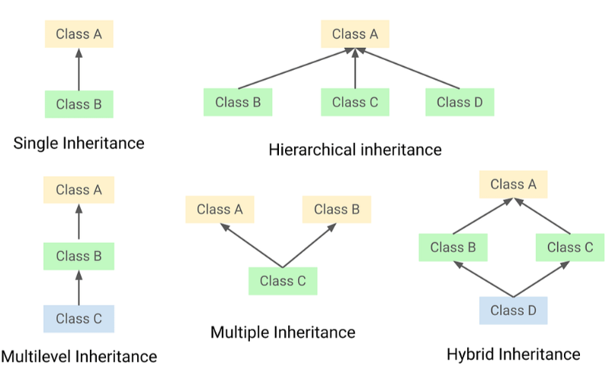
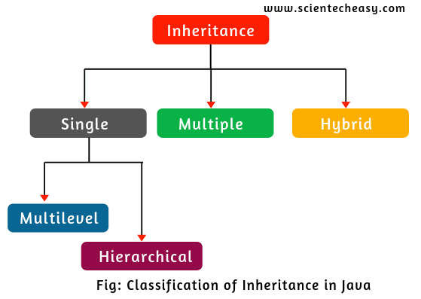
Inheritance

